Slide 1
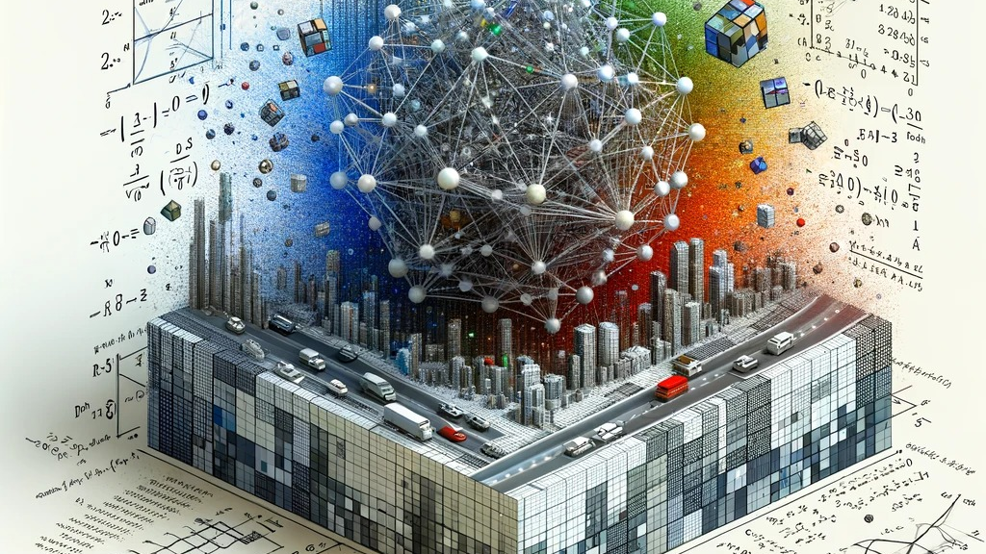
An Integrated Data Cyber Infrastructure (CI) to Accelerate Convergent Research in Domain and Computer Science.
Banu Priya Raya Krishnamoorthy
Henry Saltzman
Madhumitha Sekamuri
Ruoke Zhang

Slide 2


Introduction
Leveraging Convergent Research in GNN Applications for Road Accident Prediction includes
Integrating traffic engineering insights with advanced data science methodologies.
Utilizing environmental and urban planning data to enhance predictive accuracy.
Fostering interdisciplinary collaboration for holistic road safety solutions.

Slide 3

Literature Review
Keyword Strategy for Literature Selection: Employ specific keywords like "road accident prediction models," "traffic accident analysis," "GNN in traffic safety," and "predictive analytics in road safety" to refine and target relevant research papers.
CrashFormer: A Multimodal Architecture to Predict the Risk of Crash
Will there be a construction? Predicting road constructions based on heterogeneous spatiotemporal data
Traffic Accident Prediction using Graph Neural Networks: New Datasets and the TRAVEL Model
A study on road accident prediction and contributing factors using explainable machine learning models

Slide 4
Research Methodology Design
1. Data Collection and Integration
2. Data Preprocessing
3. Graph Construction
4. GNN Model Selection and Development
5. Training and Validation
6. Model Evaluation
7. Deployment and Real-Time Integration

Slide 5

Research Question
How can we create a real-time forecasting model to predict road accidents in different regions based on weather conditions, traffic congestion and road types, determining the likelihood of an accident occurrence?

Slide 6
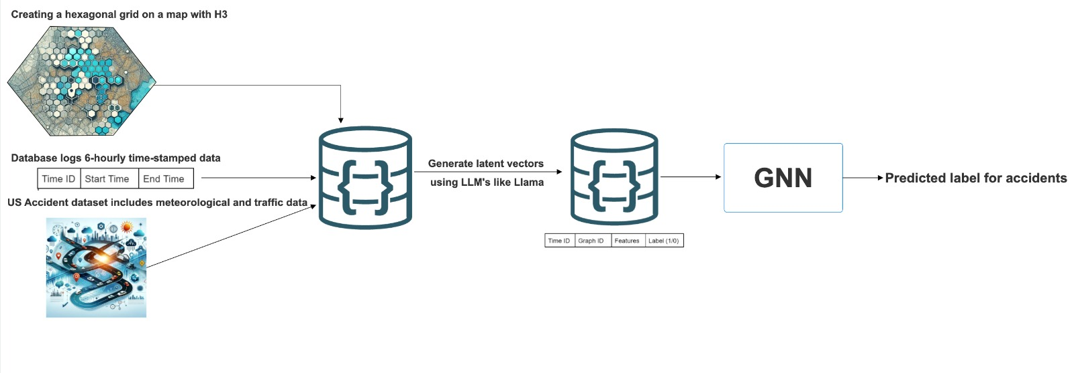
High Level Project Design
Notes:
The process begins with the creation of a hexagonal grid on a map with the H3 library, which allows for efficient geospatial analysis by dividing the map into hexagonal cells. This spatial division is crucial for pinpointing the locations of accidents and associating them with particular areas on the map.
Next, the pipeline involves collecting data from a database that logs information with a 6-hourly timestamp. This data includes start and end times for each period, allowing the model to understand the temporal context of accidents. The data is sourced from the US Accident dataset, which includes not just temporal and locational data, but also important contextual information such as meteorological and traffic data. This comprehensive dataset provides the model with a rich set of features that can influence the occurrence of accidents.
The raw data is then processed to generate latent vectors using Large Language Models (LLMs) like Llama. LLMs are adept at extracting meaningful patterns and representations from large datasets, which can then be used to inform the predictive model. These latent vectors serve as condensed representations of the data's features, capturing the essential information needed for the next stage of prediction.
The processed data, now in the form of latent vectors, is fed into a Graph Neural Network (GNN). GNNs are particularly suited for this task as they excel at working with data that has a graph structure, such as the connections between different locations on a map. The GNN considers the features of each node (in this case, hexagonal cells on the grid) and the edges (connections between cells) to learn the complex relationships between different factors that lead to accidents.
Finally, the output of the GNN is a predicted label for accidents, indicating the likelihood of an accident occurring in each cell of the hexagonal grid. This prediction can be used by various stakeholders, such as city planners and traffic management authorities, to implement preventive measures, optimize traffic flow, and enhance road safety.
Overall, this design diagram illustrates a sophisticated approach to accident prediction that leverages the spatial-temporal nature of accident data, advanced machine learning techniques, and the powerful capabilities of GNNs to produce actionable insights.

Slide 7
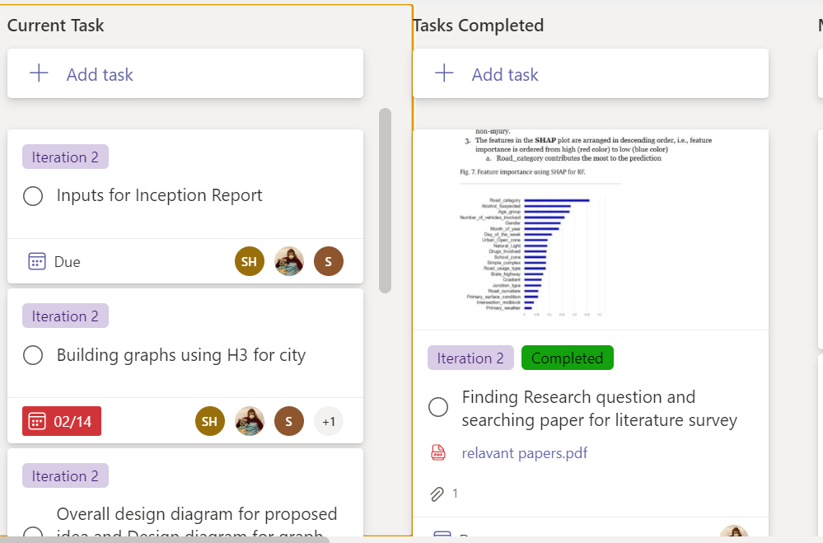
Task Organization

Slide 8
Releases and iterations
Project Setup and Initial Data Gathering [February – March 5]
Iteration 1: Project Kickoff
Define objectives, team roles, and timelines.
Initial stakeholder meetings for scope and expectations.
Iteration 2: Data Collection Framework
Identify data sources for weather, road types, and traffic congestion.
Set up data collection and storage infrastructure.
Data Preprocessing and Model Prototyping [March 5 – March 15]
Iteration 3: Data Preprocessing and Latent Vector Generation
Clean and preprocess data.
Generate latent vectors using LLMs like LLaMA.
Iteration 4: Basic Model Development with Latent Vectors
Develop initial predictive model using latent vectors.
Initial model training and evaluation.

Slide 9
Model Refinement and Evaluation [March 15 – March 31]
Iteration 5: Advanced Modeling with Latent Vector Integration
Integrate advanced algorithms with latent vectors.
Iterative model training and tuning with full dataset
Iteration 6: Model Evaluation and Latent Vector Optimization
Test and validate model focusing on latent vector effectiveness.
Collect stakeholder feedback on model performance.
Application Development and Integration [ April ]
Iteration 7: Application Development
Develop application/interface for model interaction.
Integrate model with application for forecasting.
Iteration 8: System Testing and User Feedback
Comprehensive application testing.
Gather user feedback for improvements.

Slide 10
Risks for Elaboration Stage
Insufficient Theoretical Understanding - Limited grasp of ML and GNN concepts may lead to foundational knowledge gaps.
Data Handling Challenge - Inexperience in preprocessing, feature selection, and managing large datasets.
Model Complexity and Overfitting - Risk of creating overly complex models prone to overfitting.
Integration Issues - Challenges in integrating GNNs with existing infrastructure for real-time predictions.
Evaluation and Validation Difficulties - Difficulty in selecting appropriate evaluation metrics and validation techniques.
Scalability Concerns - Limited understanding of scaling models to handle diverse data sources.
Resource Limitations - Challenges in accessing high-performance computing resources for training complex models.
Time Management Issues - Steep learning curve may impact project timeline and management.

Slide 11

Thank you

